Slide 1
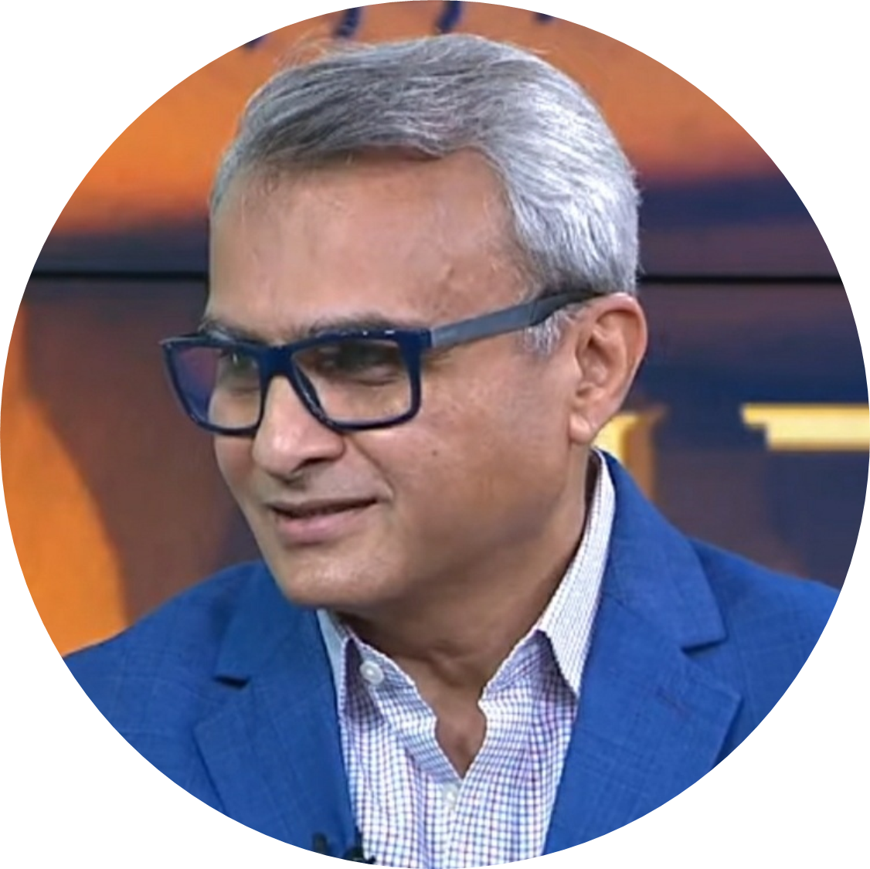



One on One
With
MisterBond
Videos
July 10’2021

Slide 2

Where to Locate Videos?

Slide 3
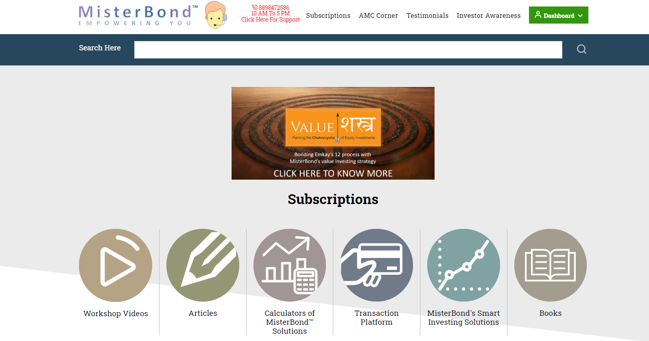
Home Page Workshop Videos
www.misterbond.in – Home Page
Round Icon of Workshop Videos
Videos relating to enhancement of your Mutual Fund Practice (58 Videos)
25 Videos under Wealth Accelerator – To help you create your IAPs
Under MisterBond’s Page – Walkthrough Videos of Platform (5 Videos)

Slide 4

Certifications
Those who have taken Package with Videos, should opt for Certification
Done over 4 months with viewing 15 videos each month and giving monthly exams
Almost 1,000 Wealth Managers of a Bank and RMs of two Mutual Fund Houses have been certified through this course

Slide 5
Home Page – Value Shastra
www.misterbond.in – Home Page
Click on the icon of Value Shastra
It will take you to Website: www.valueshastra.com
On the Homepage of ValueShastra.com – Video explaining PMS of Emkay’s 12 with MisterBond’s solutions

Slide 6
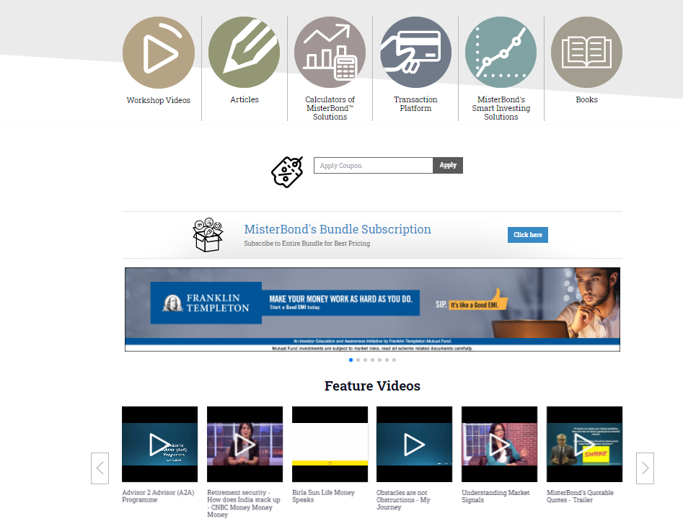
Home Page – Feature Videos
www.misterbond.in – Home Page
Under Feature Videos
Interviews of MisterBond with CNBC, Bloombergquint, Birla Life Money Speak, MisterBond’s Quotable Quotes, His Professional Journey – Hero to Zero to Hero, ET Now, Interview – Brand Called You, Interview – His Book Review

Slide 7
Home Page - Calculators
www.misterbond.in – Home Page
Under Icon of Calculators
4 Videos explaining how to use the Calculators

Slide 8
Home Page – Transaction Platform
www.misterbond.in – Home Page
Under Icon of Transaction Platform
2 Webinar Recordings on how to use MFU & BSE StAR MF Platforms

Slide 9
Home Page – Smart Investment Solutions
www.misterbond.in – Home Page
Under Icon of Smart Investing Solutions
1 Webinar on Smart Solutions

Slide 10
Home Page – AMC Corner
www.misterbond.in – Home Page
Under AMC Corner on Top
MisterBond’s Page – All his Webinar Recordings
AMC Pages – Their respective Product Videos and Webinars sponsored by them

Slide 11
Home Page – Investor Awareness
www.misterbond.in – Home Page
Under Investor Awareness on Top
AMC Pages – Motilal Oswal Page – Mutual Funds for All – No Age Limit – 48 Video IAP conducted by MisterBond
Axis MF Page – Income Fund Fundas – 48 Video series on Debt Markets and Asset Allocation
Other AMC Pages – Respective AMC Videos on IAP

Slide 12

Where to Locate Articles?

Slide 13
Home Page – Articles
www.misterbond.in – Home Page
Under Icon of Articles
Various articles on Concepts, Products, Crisis, etc. dating back to 2013
Use Search Bar – by typing relevant topic like SWP, BAF, Senior Citizens, to look for specific articles

Slide 14



www.misterbond.in
/IamMisterBond
/IamMisterBond

Slide 15
Changes to be made
Workshop Videos:
Remove Debt Program (posted twice)
Create 3 Video Workshops of Webinars with NLMB Pathshala (Financial Independence and Asset Allocation)
From MisterBond’s Page – Remove Webinar Recording – Looking Back to Looking Forward – Take it to Webinar Section
Feature Videos:
Remove: COFP Video, Webinar –Looking Back to Looking Forward
Add: Interviews with Bloombergquint, Wealthforum on Ranking, Interviews with ET Now, My Book Review Interview
Under Calculator: Add Webinar on Ranking Calculator
Under Transaction Platform – remove video of webinar on Platform – replace with two webinars on how to use Transaction Platforms
Under Smart Solution Icon: Remove current video – replace with Full Webinar (based on PPT under Algo)
AMC Corner Page: MisterBond’s Page – keep only recordings of all his Webinars
AMC Corner – AMC Pages – Their product videos and video recordings of Webinars sponsored by them
Investor Awareness Page: MisterBond’s Page – Put these videos under Webinars under AMC Corner (MB’s Page)

Slide 16
DISCLAIMER
Mutual Fund investments are subject to market risks, read all scheme related documents carefully.
This document is issued for information purposes only. It is not an offer to buy or sell units or shares of funds, or the solicitation of any offer to buy or sell units or shares of funds, which offer can only be made pursuant to the offering document (s) of the relevant funds. Investment involves risk. Please refer to the respective offering documents.
Informational sources are considered reliable but you should conduct your own verification of information contained herein. No warranty is made to the accuracy, suitability or completeness of any information and no liability in respect of any errors or omissions (including any third party liability) is accepted by MSJ MisterBond Pvt Ltd , or any of his employees, officers or agents.
Any forecasts or opinions expressed are of MSJ MisterBond Pvt Ltd or the respective AMCs (Asset Management Companies) (as the case may be) as of the date of publication of this document and may be subject to change without notice. The value of investments and the income from them may fluctuate and your investment is not guaranteed. Past performance is not necessarily a guide to future performance and investors should be aware that the value of units or shares of the relevant funds and the income from them may fall as well as rise and they may not get back the full amount invested. Also, the economic and political situations may adversely influence the value of investments made. All copyright, patent, intellectual and other property rights in the information contained herein is owned by MSJ MisterBond Pvt Ltd or the respective AMCs (Asset Management Companies) and/or their respective affiliates. No rights of any kind are licensed or assigned or shall otherwise pass to persons accessing such information. Under no circumstances should information contained herein or any part of it be copied, reproduced or redistributed.

